Slide 1
Image Classification with CNN
INTERNAL GUIDE: Group Members: (Batch-18)
Ms Neha Jhunjhunwala Madhan – 18311A05L9
Shashank – 18311A05Q0
Karthik – 19315A0519

Slide 2
Contents
1. Abstract
2. Modules Used In The Project
3. Architecture
4. Usecase Diagram
5. Class Diagram
6. Activity Diagram
7. Sequence Diagram
8. How CNN’s Work
9. Conclusion

Slide 3
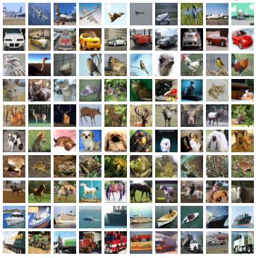
ABSTRACT
Image classification is the most critical use case in digital image analysis.
CIFAR-10 is a very popular computer vision dataset. This dataset is well studied in many types of deep learning research for object recognition.
This dataset consists of 60,000 images divided into 10 target classes, with each category containing 6000 images of shape 32*32. This dataset contains images of low resolution (32*32), which allows researchers to try new algorithms. The 10 different classes of this dataset are:
Airplane
Car
Bird
Cat
Deer
Dog
Frog
Horse
Ship
Truck
CIFAR-10 dataset is already available in the datasets module of Keras. We do not need to download it; we can directly import it from keras.datasets.

Slide 4
Modules used in project
Some of the modules used are numpy, matplotlib, seaborn, pandas and keras.
The numpy module is used to deal with the multidimensional arrays
The matplotlib and seaborn are used for the visualization purpose.
The pandas provides ready to use high-performance data structures and data analysis tools.
The keras module contains the Cifar10 dataset along with some of the useful libraries such as keras.models, keras.layers, keras.utils, keras.optimizers.

Slide 5
Architecture
Import Libraries
Import Cifar10
Preprocessing
Visualization
One-hot encoding
Train test split
Initialize CNN model
Adding layers
Adding Optimizer
Train the model on CNN’s
Prediction

Slide 6
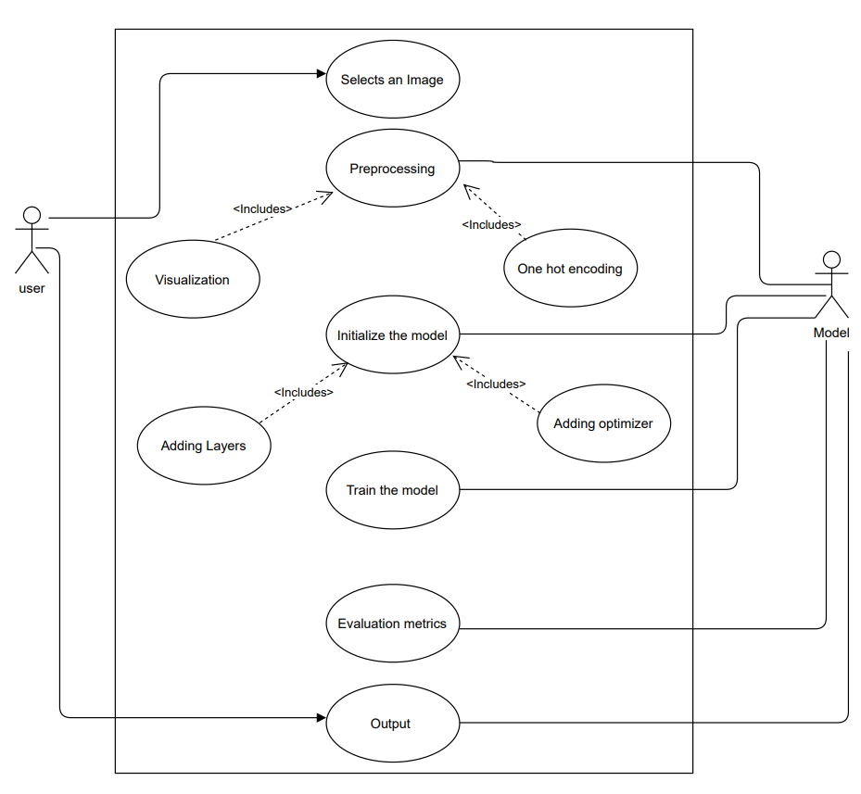
Usecase Diagram

Slide 7
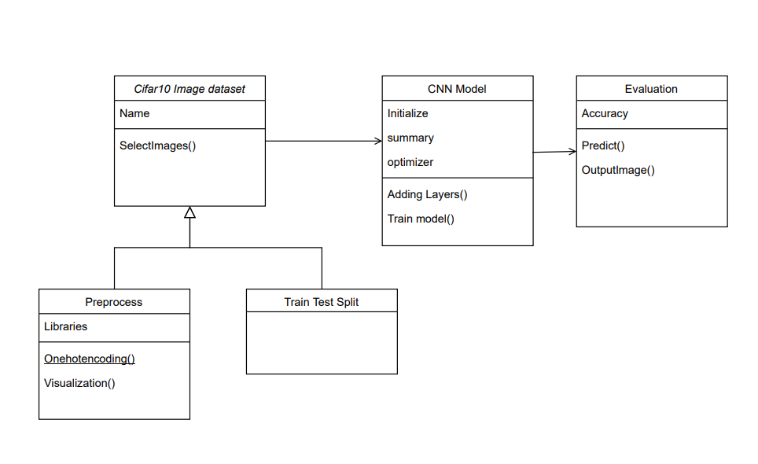
Class Diagram

Slide 8
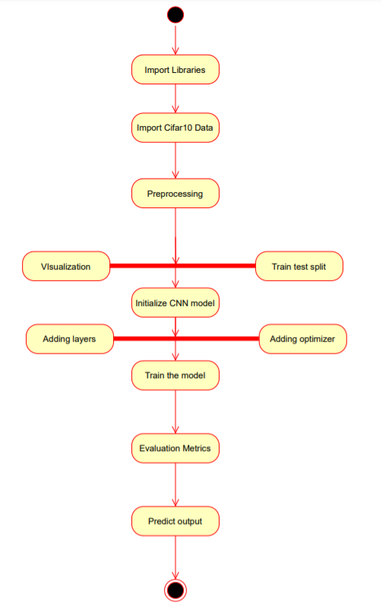
Activity Diagram

Slide 9
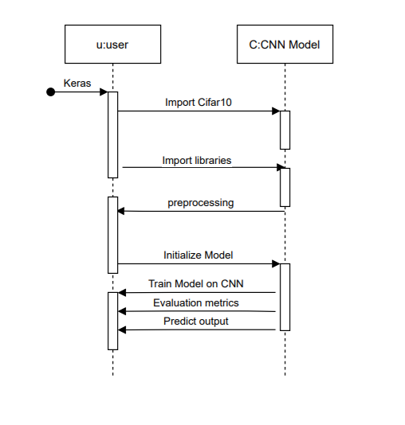
Sequence Diagram

Slide 10
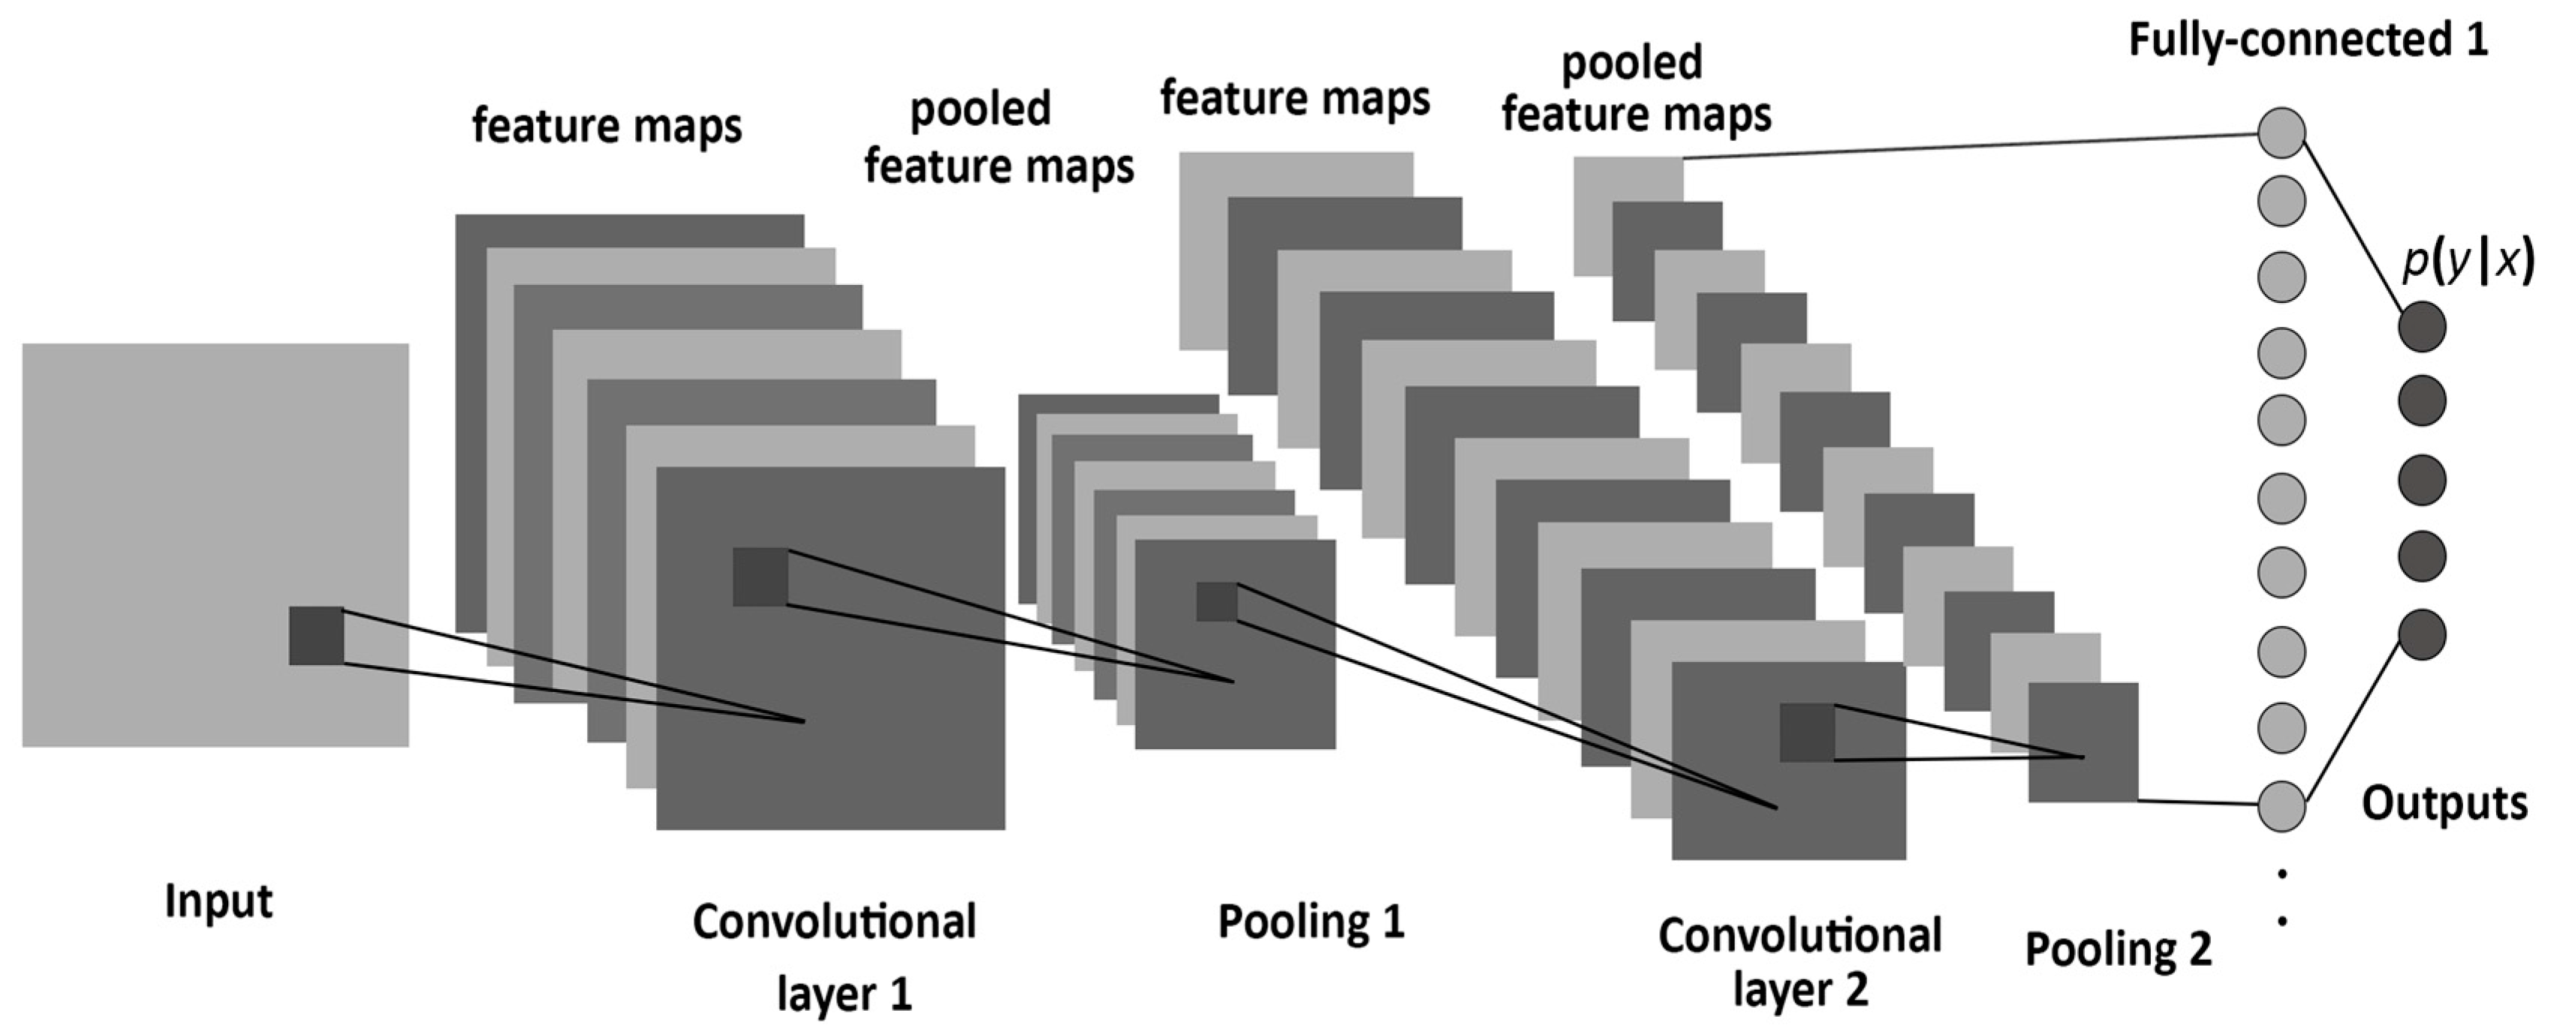
How CNN’s Work?

Slide 11
convolutional layer… Layer at which convolution operation takes place
Filter / kernel : A matrix which contains weights , which are learnt through back propagation , used to detect the edges and features from a given input image.
Feature Map: output generated when a filter is convolved over input image.
Convolution operation: This technique involves the process of convolving a given filter over an input image to attain feature map .This is what happens in the convolutional layer.
Padding: Adding an extra layer throughout the circumference of our original image to retain it’s features without being shrinked, by convention we pad with zeros.
It is a hyperparameter , in this example p=1

Slide 12
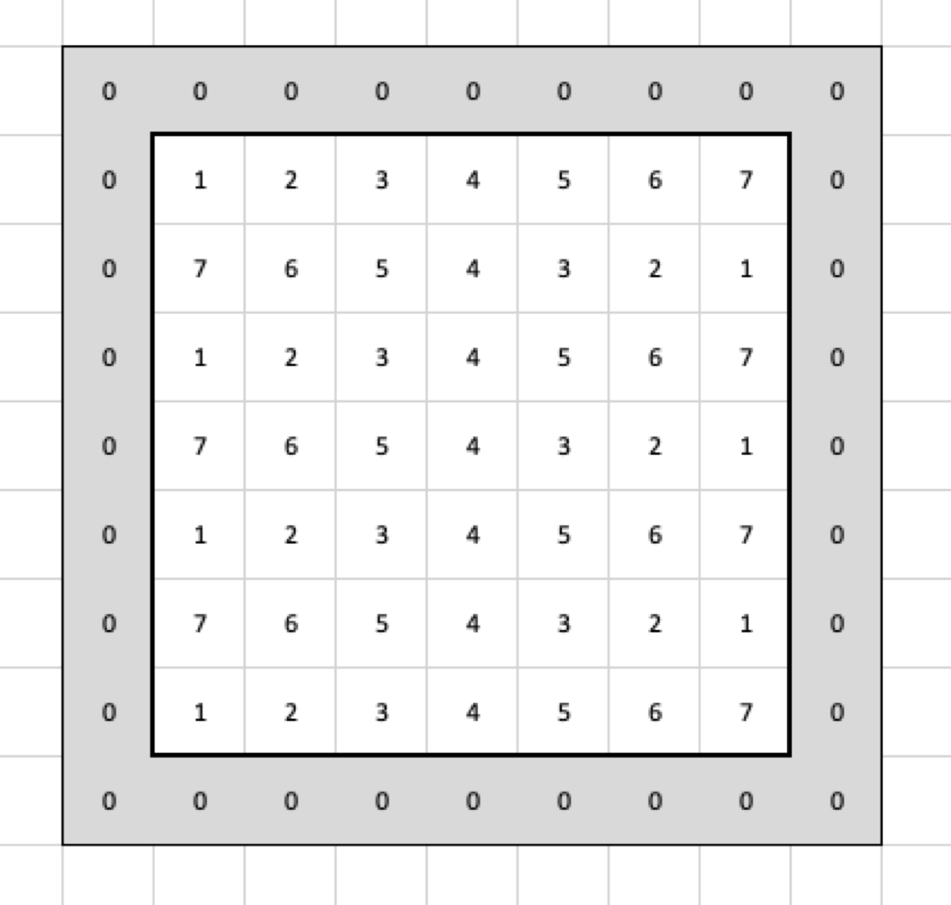
Reasons for why we go for padding :
1.As the convolution operation happens repeatedly there is a problem of our input image being shrinked, so it’s original from will be lost till it reaches the last step.
2.When filter is convolved over an input image , then only once the top left corner is occurred and pixel in the middle would come several times, this leads to throwaway of information from corners.
Stride=2
Stride=1
STRIDE: Stride is the amount by which the kernel is moved by as the kernel is passed over the image.
Stride in this context means the step of the convolution operation, it is also a hyperparameter.

Slide 14
Pooling layer:
Other than convolutional layer , ConvNets often also use pooling layers
To reduce the size of the representation.
To speed the computation.
Make some of the features that detects a bit more robust.
There can be various types of pooling but two of them are most commonly known by all:
Max pooling
Average pooling
Example for max pooling:
1 | 3 | 2 | 1
2 | 9 | 1 | 1
1 | 3 | 2 | 3
5 | 6 | 1 | 2
9 | 2
6 | 3
2x2 filter
Stride=2
4x4
2x2

Slide 15
Fully connected layer…
A fully connected layer also known as the dense layer, in which the results of the convolutional layers are fed through one or more neural layers to generate a prediction.
In case of a fully connected layer, all the elements of all the features of the previous layer get used in the calculation of each element of each output feature, this also includes an activation function based on our business requirement.
In between the convolutional layer and the fully connected layer, there is a ‘Flatten’ layer. Flattening transforms a two-dimensional matrix of features into a vector that can be fed into a fully connected neural network classifier.

Slide 16
Conclusion
The CNN is a type of Deep Neural Networks (DNN) that consists of many layers such as the Conv layers, Pooling layer, and the fully-connected layer.
Convolutional neural networks (CNNs) are widely used in pattern- and image-recognition problems as they have a number of advantages compared to other techniques.
CNN’s has its own importance in the field of computer vision with wide many applications.
The Cifar10 dataset imported from keras has the 10 classes and we build a model such that our model predicts the given image with a far decent accuracy.
The image classification is just on of the vital applications of computer vision and it has helped in understanding the convolution operation and various layers involved in Convolutional neural networks.
As the future is going to be more towards automation and digitalization these technologies would definitely help us in understanding what happens behind the scenes.

